Slide 1
Coursera ML Capstone Project
The Battle of Neighborhoods, finding an ideal place in North York Toronto

Slide 2
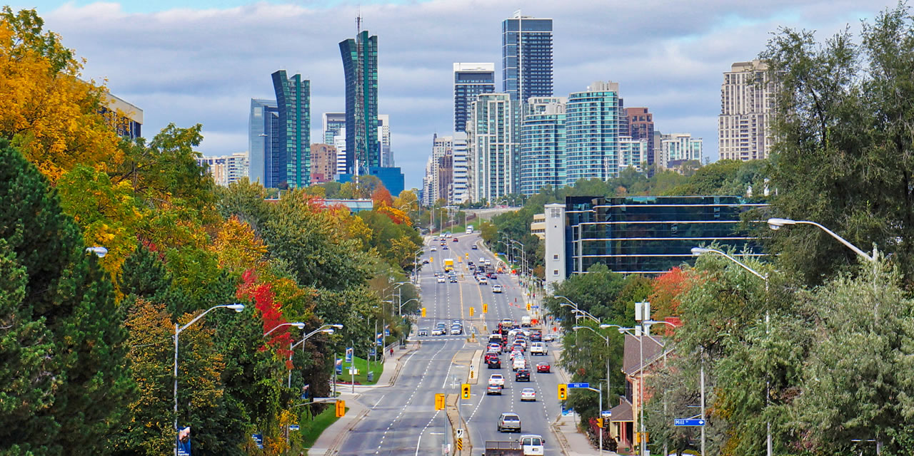
North York

Slide 3
Purpose
To help people in exploring better facilities around their neighborhood. It will help people making smart and efficient decision on selecting great neighborhood out of numbers of other neighborhoods in North York, Toronto.

Slide 4
Conclusion
As we have seen the majority of neighbourhoods are everyday service shops. A mixed bag North York has it all and certainly makes up to be a excellent neighbourhood to move into.

